Slide 1
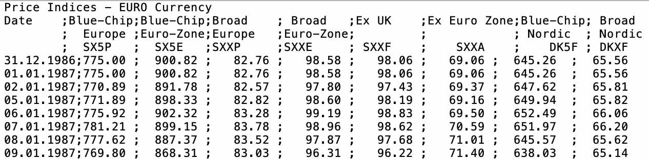
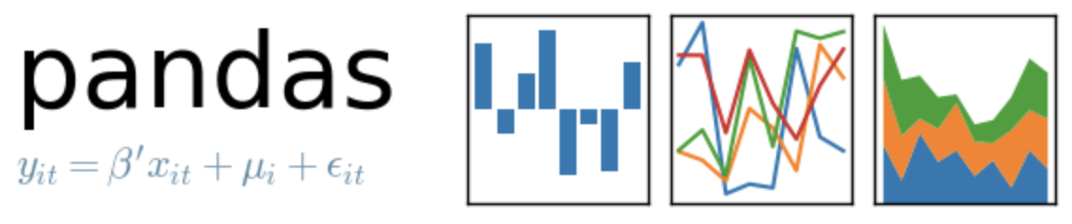
Reading Text Files using Pandas

Slide 2
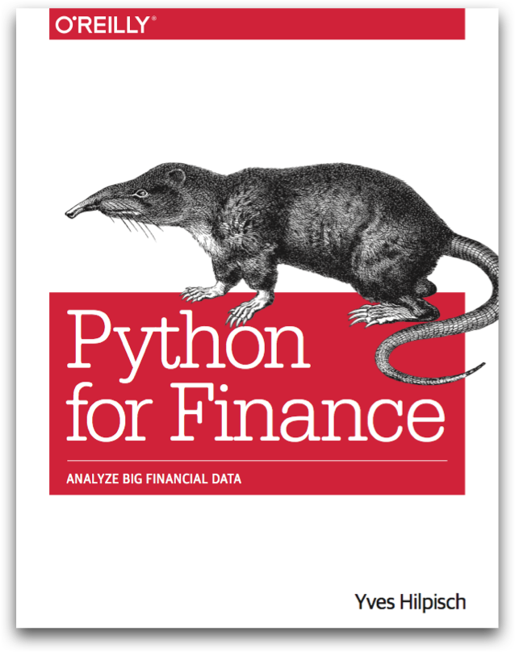
Reference
Chapter 6 of Python for Finance (O'Reilly)
Youtube
Code

Slide 3
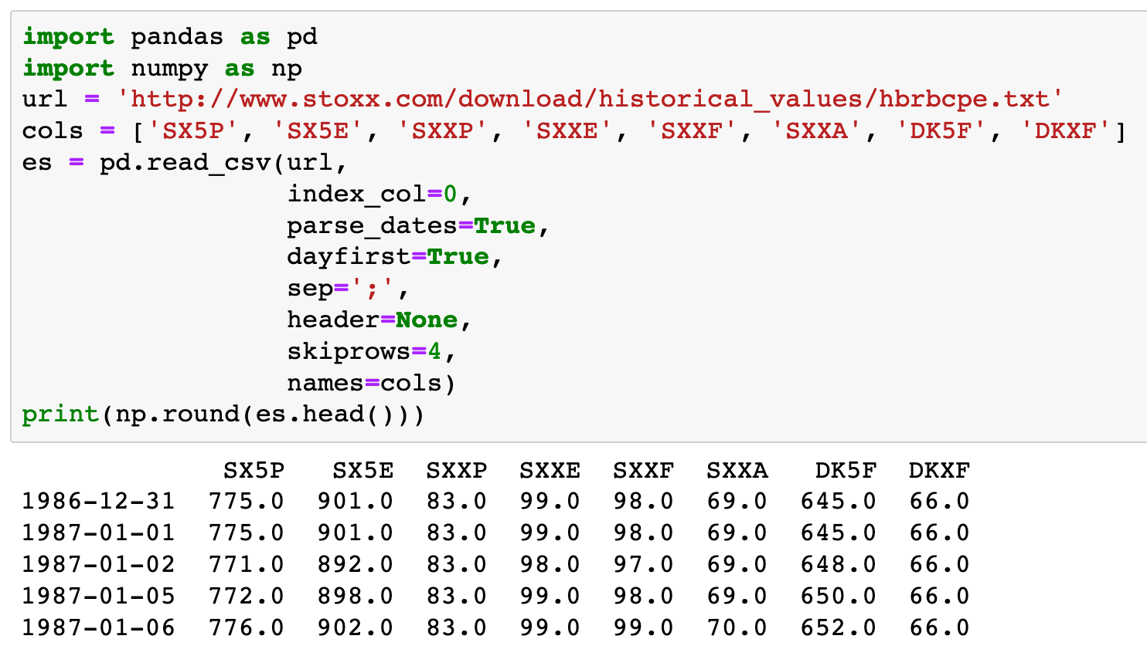

Slide 4
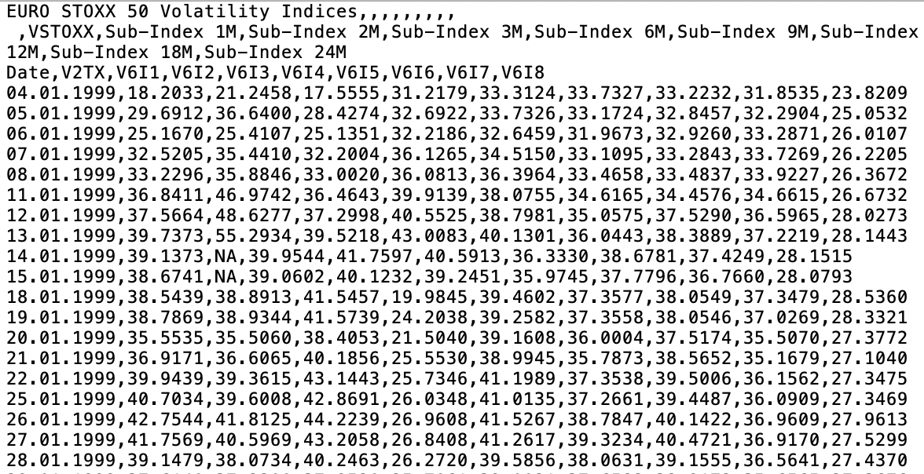
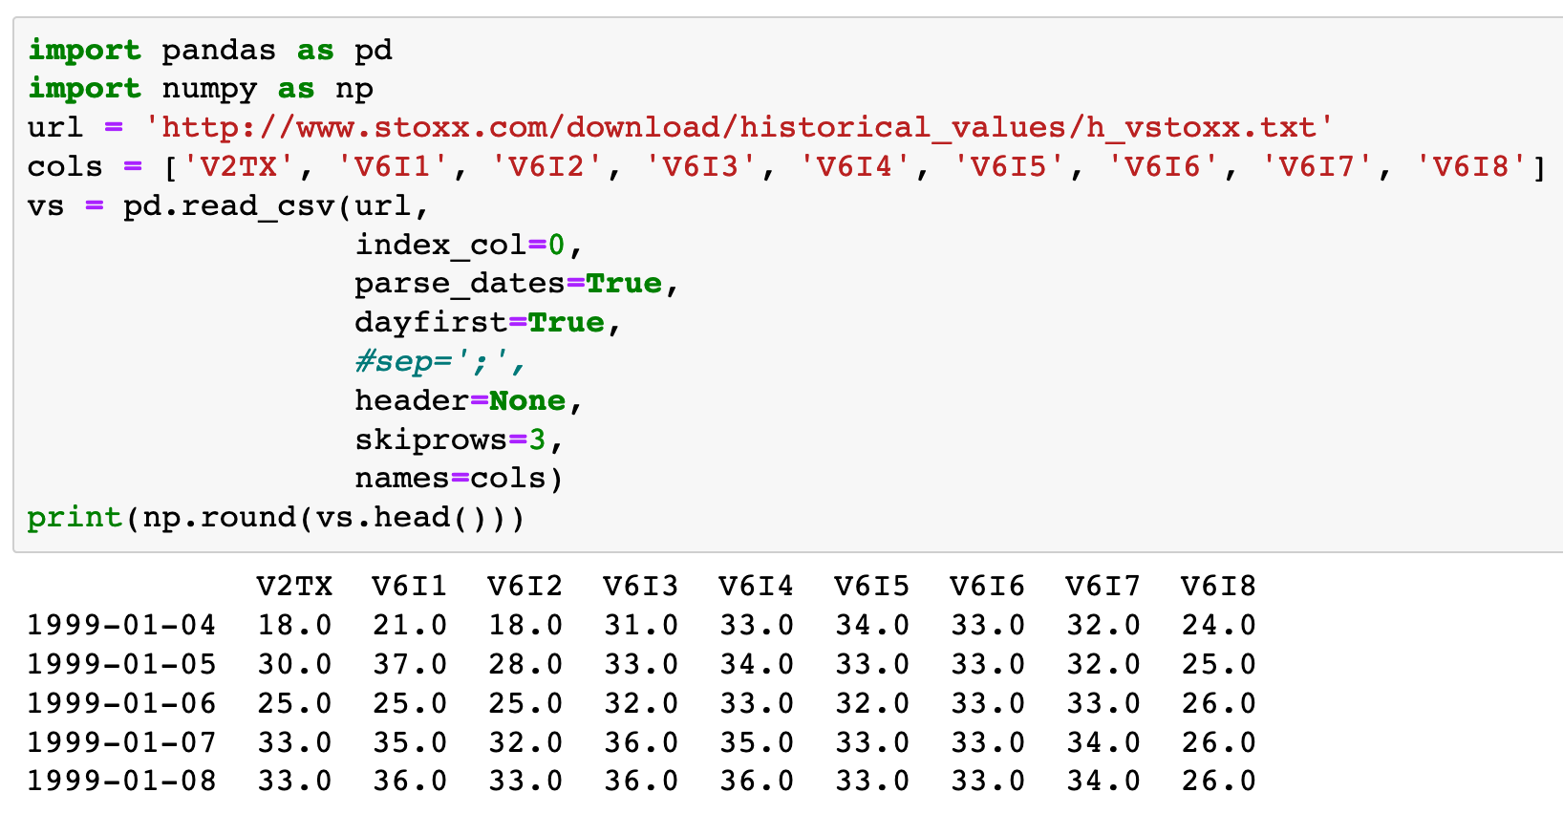

Slide 5
Bonus!
Linear Regression

Slide 6
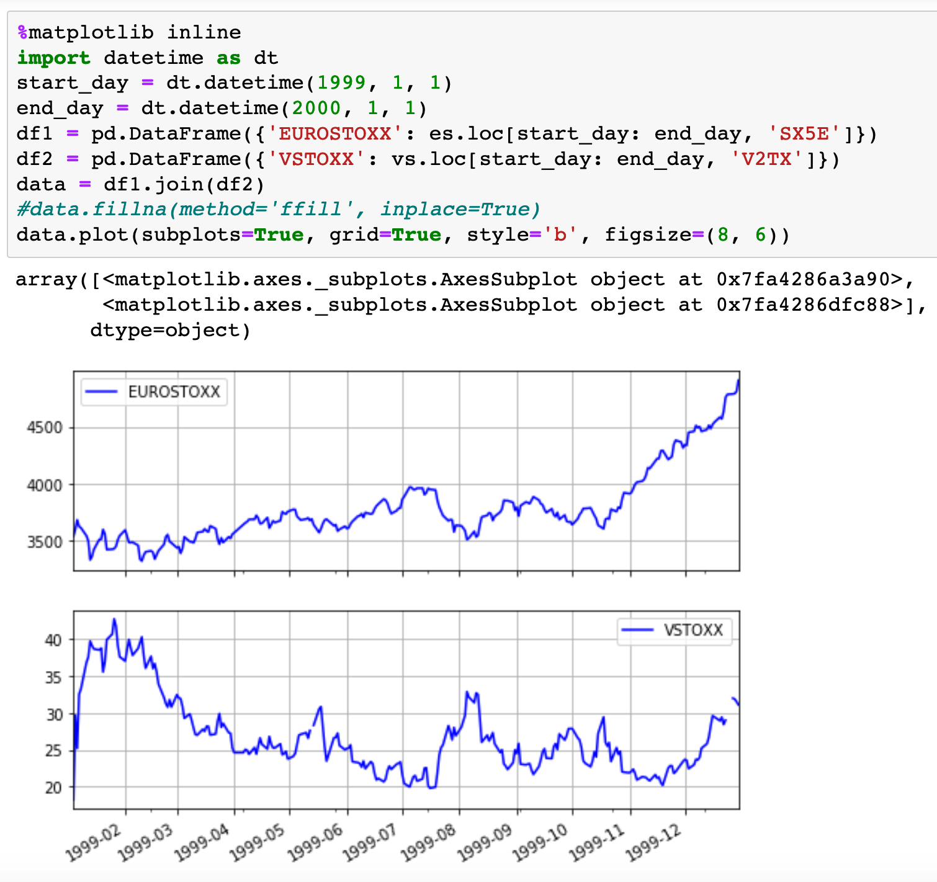
Close

Slide 7
NaN

Slide 8
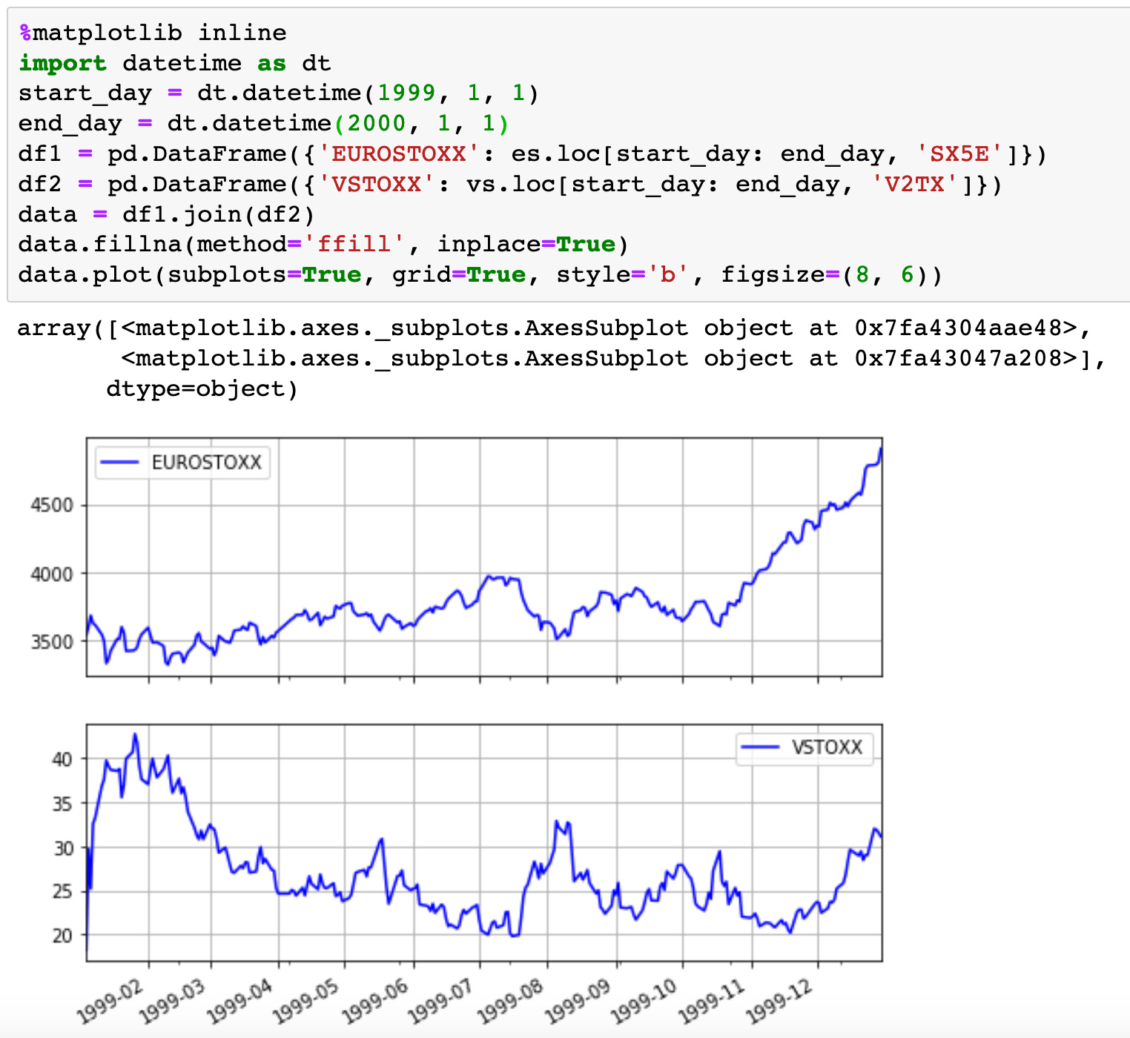
Fill NaN

Slide 9
Fill NaN
Yesterday’s Data

Slide 10
Fill NaN
Yesterday’s Data
NaN Filled

Slide 11
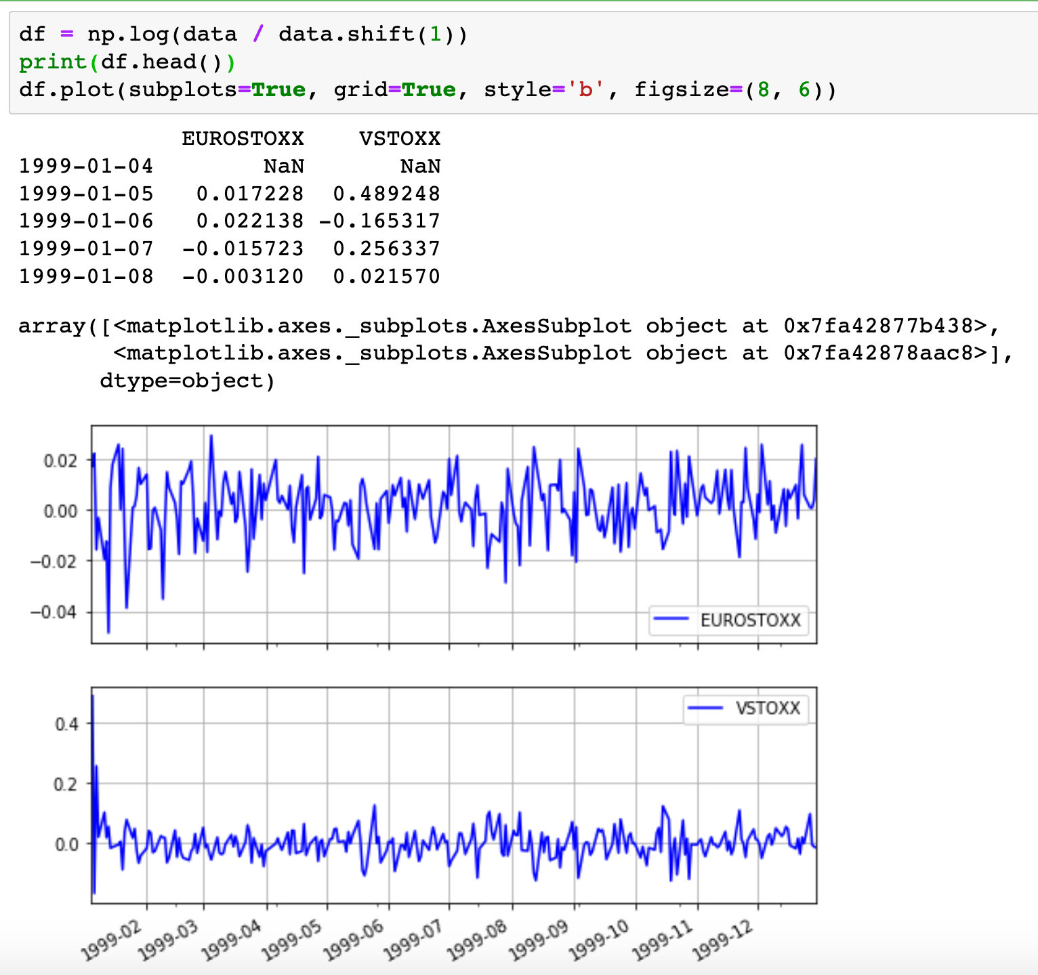
Return

Slide 12
Yesterday’s Data

Slide 13
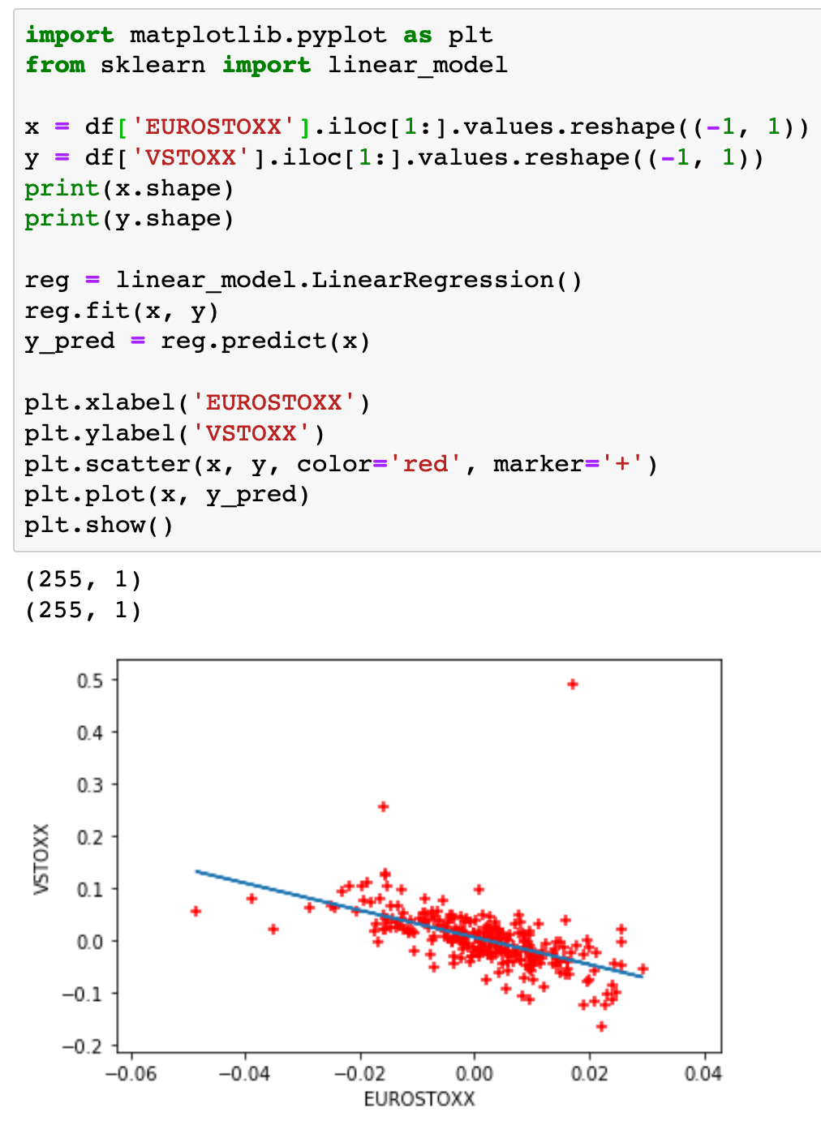
Linear Regression

Slide 14
(255, 1)

Slide 15
(255, 1)
(255, 1)

Slide 16
(255, 1)
(255, 1)
Create Object

Slide 17
(255, 1)
(255, 1)
Create Object
fit method

Slide 18
(255, 1)
(255, 1)
Create Object
fit method
predict method

Slide 19
Now
Let’s Play with Code

